Slide 1

CBP Travel Verification Services (TVS) Overview
July 31 , 2017
April 20th, 2018

Slide 2
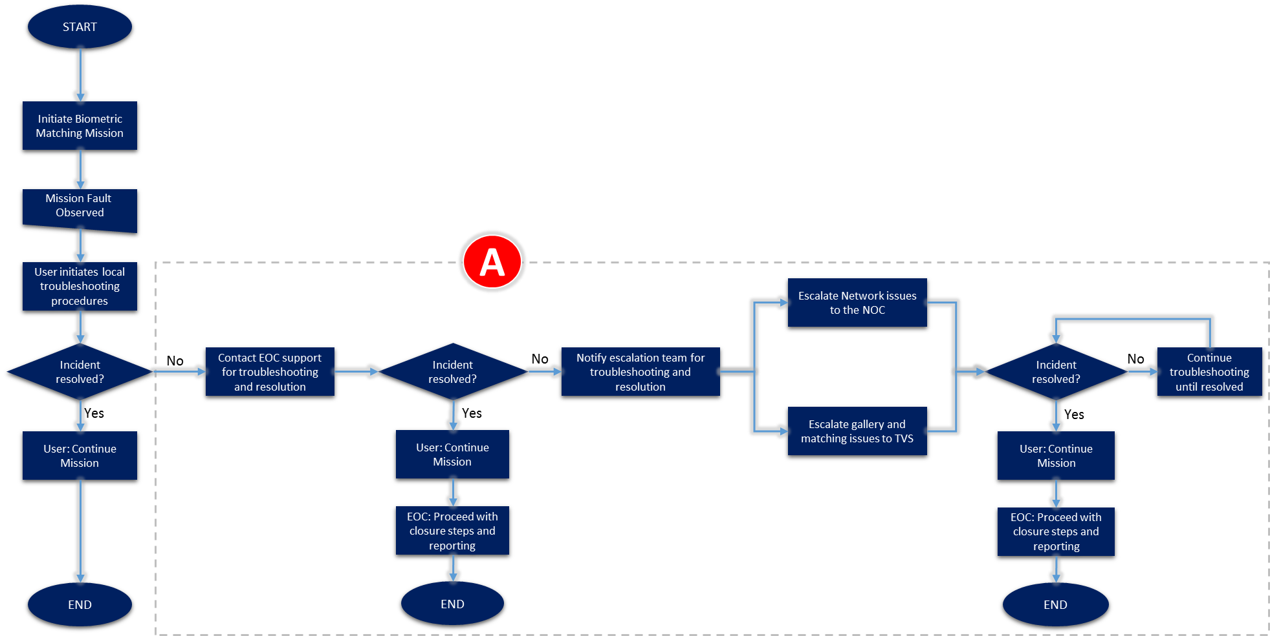
EOC Level 1 SOP: TVS Biometric Entry/Exit Program

Slide 3
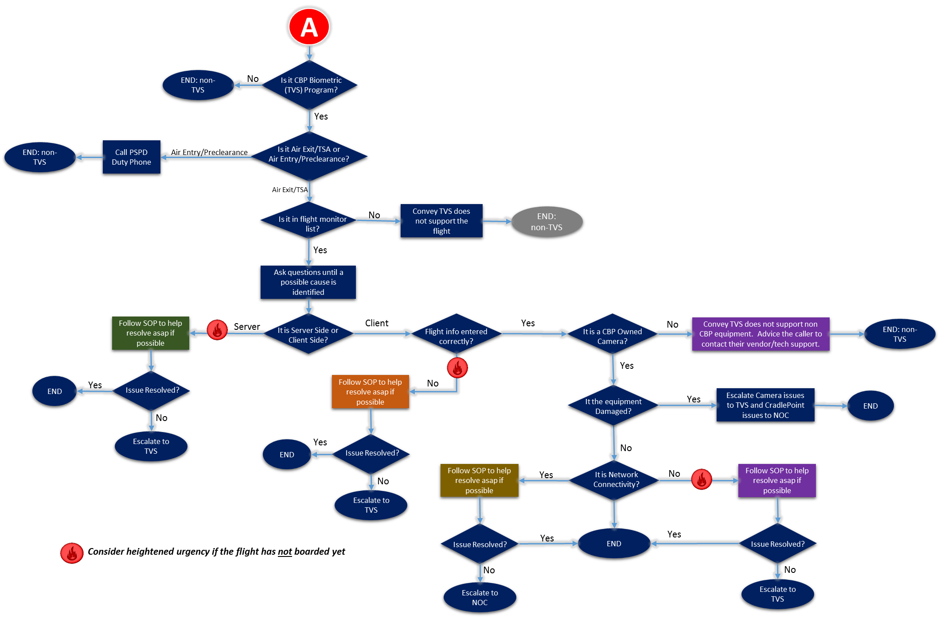
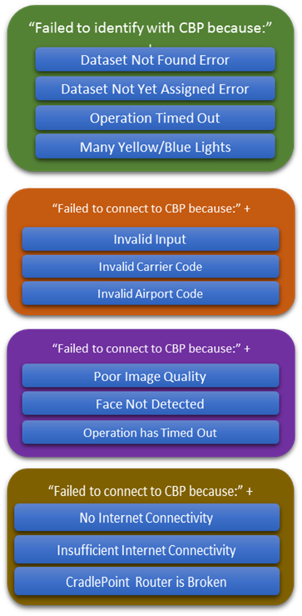
EOC Level 2 SOP: TVS Biometric Entry/Exit Program
Client Side = Local issue generally related to the camera or local connectivity.
Server Side = TVS backend gallery or match service issue.

Slide 4
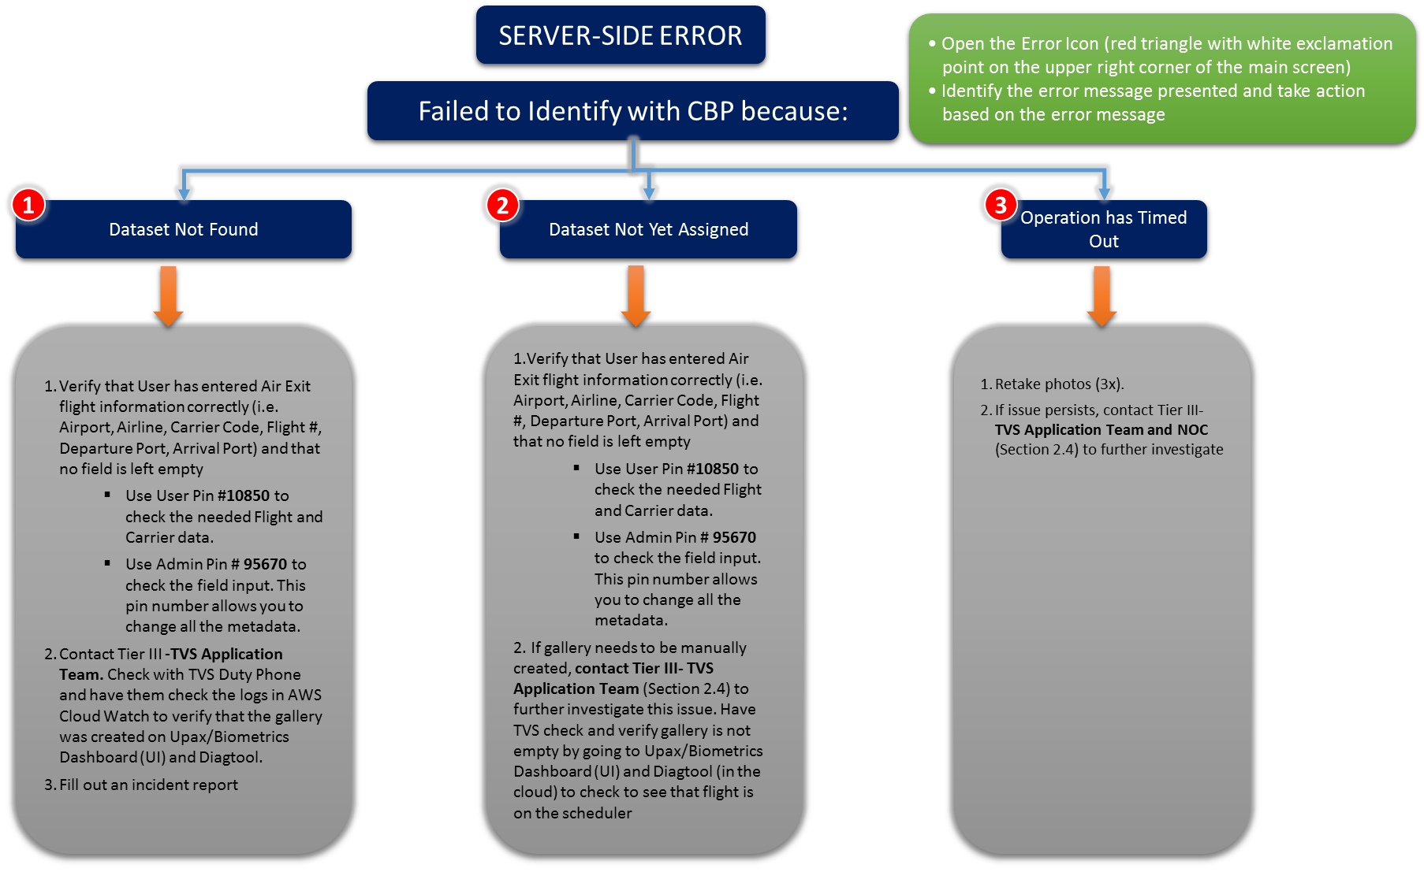
EOC Level 3 Client Side Error SOP: TVS Biometric Entry/Exit Program

Slide 5
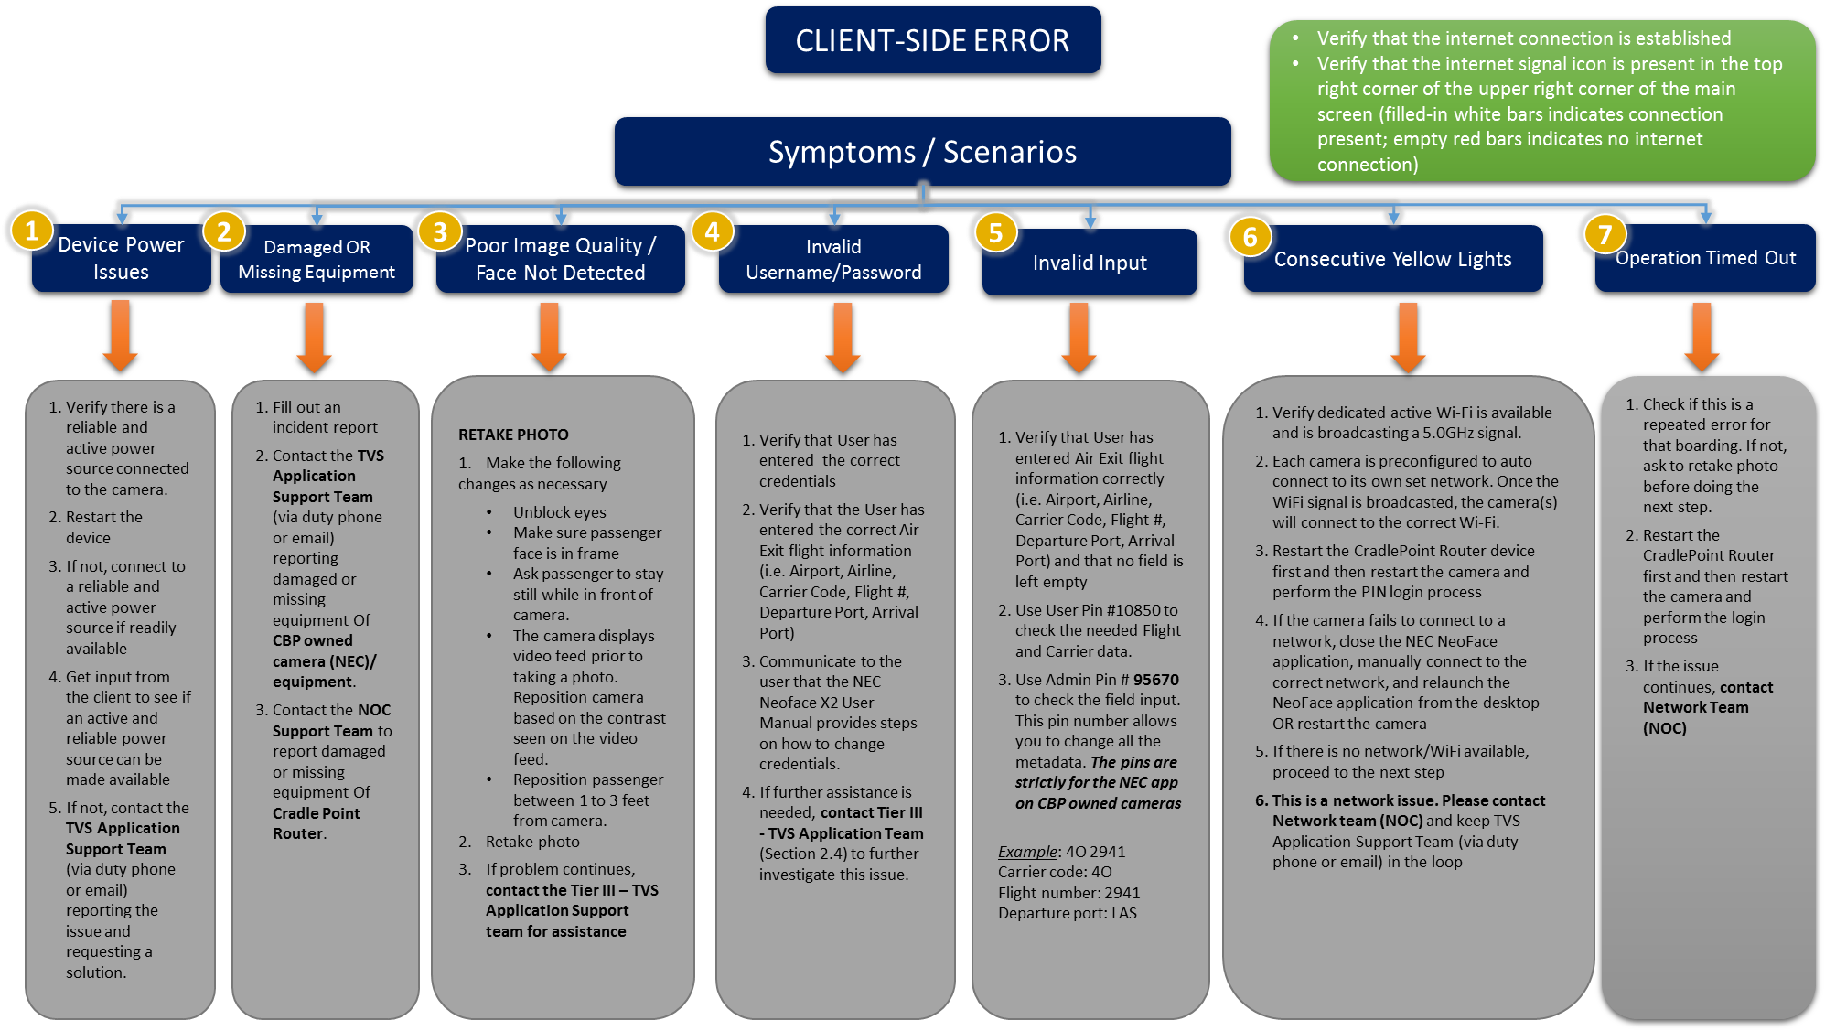
EOC Level 3 Server Side Error SOP: TVS Biometric Entry/Exit Program

Slide 6
EOC Remedy Ticket
Incident Start Date and Time Date__3/25/2018___ Time_____19:06____
Name of Caller: Officer Robert Sprague
Phone 312-659-0559
Camera Manufacturer (Model): NEC SN X2093P1
Organization: CBP DHS
Departure Port (Airport): ORD
Airline: SWIFE AIR
Flight Number: 9
Destination Port (Airport): ZRH
Gate Number: M9
Original Scheduled Flight Departure Time (UTC):19:15
Rescheduled Flight Departure Time (If Flight was delayed) no
Passenger Screening Start time: Have not boarded yet
Reported Symptom: just give the below error message.
Error Icon Message: failed to identity with the backend because data set not found.
Incident Start Date & Time (UTC): Date 3.3.18 Time: user did not know
Name of Caller: Mike Entrekin
Camera Manufacturer (Model):X2092P1
Phone: 202.550.3604
Organization: US Customs
Departure Port (Airport): Houston-George Bush
Airline: United
Flight Number: 7
Destination Port (Airport): Japan
Gate Number: E7
Original Scheduled Flight Departure Time (UTC): 10:20AM CENTRAL
Did you complete your local processes before this call?: YES
Rescheduled Flight Departure Time (if flight was delayed) (UTC): 9:30AM
Reported Symptom: When you press the “camera” on, error- program App failed to start because side by side configuration is incorrect.
Great examples of correct EOC remedy tickets with full details on error message.

Slide 7
EOC Remedy Ticket
Incident Start Date & Time (at EOC): Date 17:40 Caller Name: Officer Rosado Camera Manufacture (Model) NEC Camera Phone: 718-487-5155 or 5124 Organization: US Customs CBP Airport: JFK Airline: Egypt Flight Number: MS986 Destination Airport: Cairo Gate Number: 4 Original Scheduled Departure Time (at UTC): 18:30 Did you complete your local processes before this call:? yes Rescheduled Departure Time (if flight was delayed) (at UTC): Passenger Screening Start Time (at UTC): 17:30 What does UTC mean: (Universal Time Zone) Report Symptom: camera down Error Icon Message: red triangle upside down eye in the middle
Incident Start Date and Time Date__4/2/2018_ Time__17:30 Name of Caller: Officer SPRAGUE Phone 312-659-0559 Camera Manufacturer (Model): NEC SN unknown Organization: CBP DHS Departure Port (Airport): CHI Airline: BRITISH Airway Flight Number: 294 Destination Port (Airport): LHR Gate Number: M11 Original Scheduled Flight Departure Time (UTC):18:05 Rescheduled Flight Departure Time (If Flight was delayed) no Passenger Screening Start time: 17:30 Reported Symptom: all passenger where being mismatch. Error Icon Message: No error message
We will need more details on reported symptom and error icon message to investigate the root cause.
Full error messages looks like this:
Failed to connect to CBP because: the operation has timed out
Failed to connect to CBP because: Invalid Carrier Code
Failed to connect to CBP because: Invalid Airport Code

Slide 8
EOC Remedy Ticket
Incident Start Date & Time (UTC): Date 3.28.18 Time 1:09
Name of Caller: RUDY LESTAGE
Camera Manufacturer (Model): USER DOES NOT KNOW
Phone:516.902.3167—718.487.5426/718.487.5124
Organization: CBP
Departure Port (Airport): JFK
Airline: EGYPT AIR
Flight Number: MS986
Destination Port (Airport): CAIRO
Gate Number: USER DOES NOT KNOW
Original Scheduled Flight Departure Time (UTC): 18:30
Did you complete your local processes before this call?: USER IS NOT SURE
Rescheduled Flight Departure Time (if flight was delayed) (UTC):NO
Passenger Screening Start Time (UTC): 17:30
Reported Symptom: ANTENNA IS BROKEN
Error Icon Message: USER DOES NOT KNOW. –NO. ON RTR-356526070561448/WA165200006648
Incident Start Date & Time (at EOC): Date 04/19/2018 19:15
Caller Name: Officer Rodriguez
Camera Manufacture (Model) NEC
Phone: 305 965-0190
Organization: US Customs CBP
Airport: Miami International
Airline: American Airlines
Flight Number: 929
Destination Airport: South Brazil
Gate Number:D25
Original Scheduled Departure Time (at UTC): 19:55
Did you complete your local processes before this call:? n
Rescheduled Departure Time (if flight was delayed) (at UTC): no
Passenger Screening Start Time (at UTC): 19:05
What does UTC mean: (Universal Time Zone)
Report Symptom: Flight paused due to technical problems
Error Icon Message: Failed to connect to the backend camera not connecting – rebooted the camera several times
These are the issues that need to be escalate to NOC instead of TVS.
The NOC handles network connectivity issues including Cradlepoint configuration and hardware damage.
Example: elevate the following issue to the NOC, not TVS:
NEC Camera displays error message the operation has timed out (network traffic issue)
3 or more consecutive yellow lights (no Wi-Fi or network connection available)
Damaged Cradlepoints/ broken antenna

